Slide 1


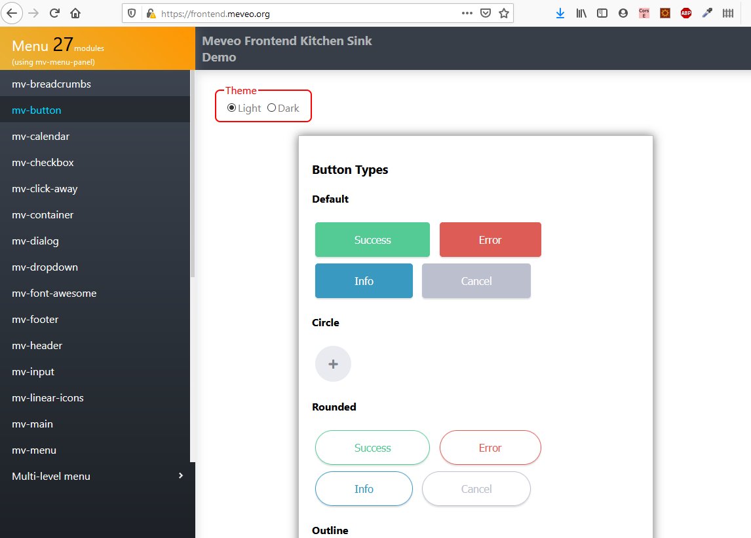
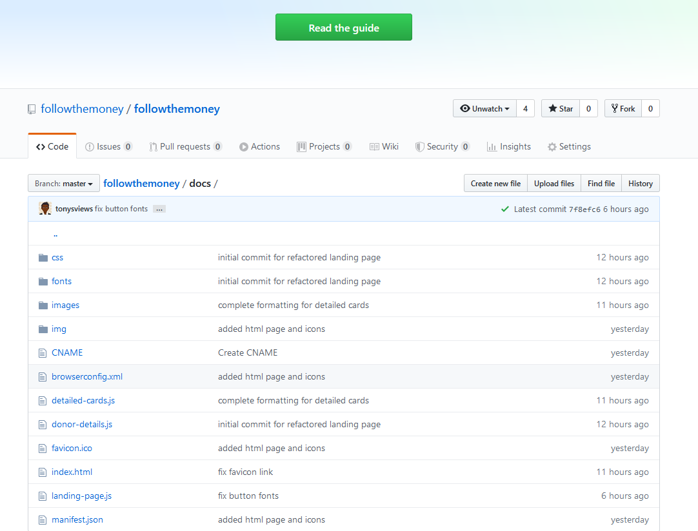
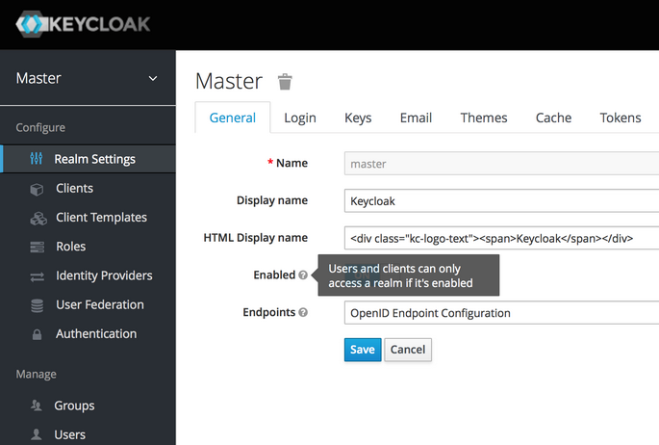
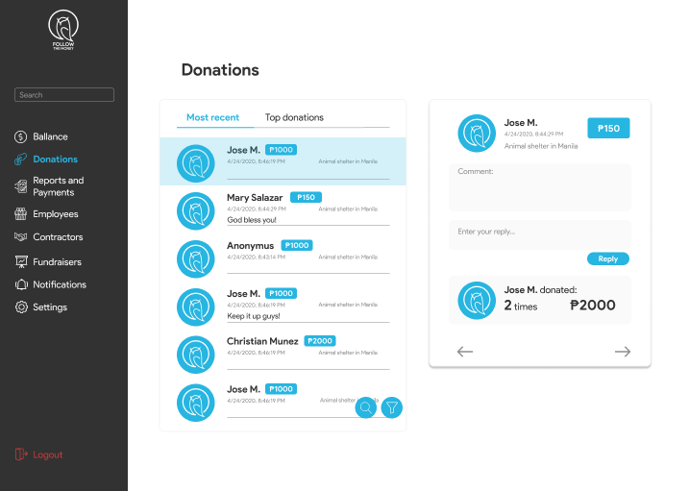
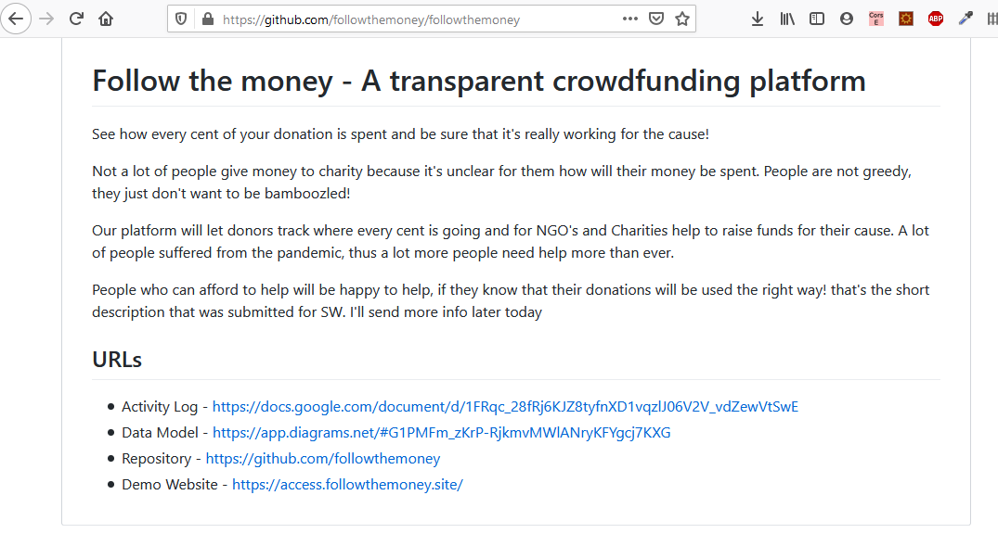

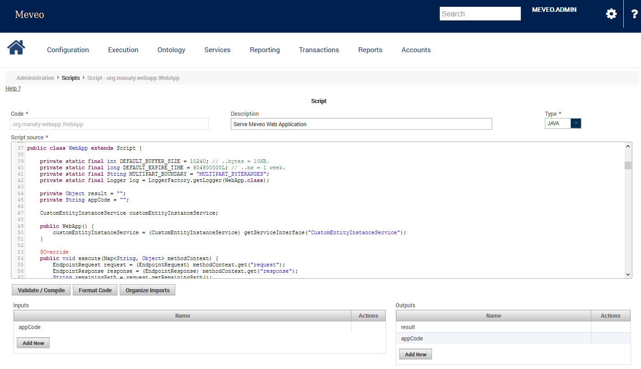
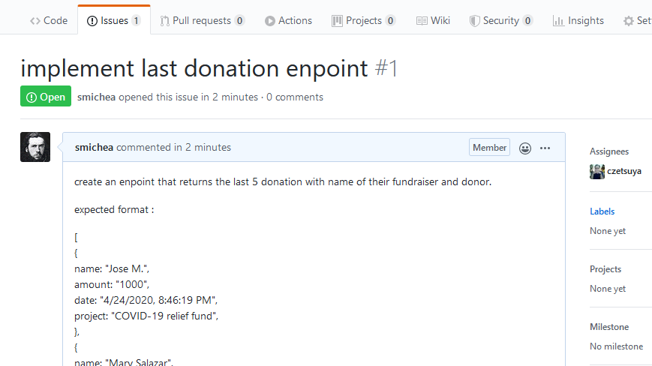
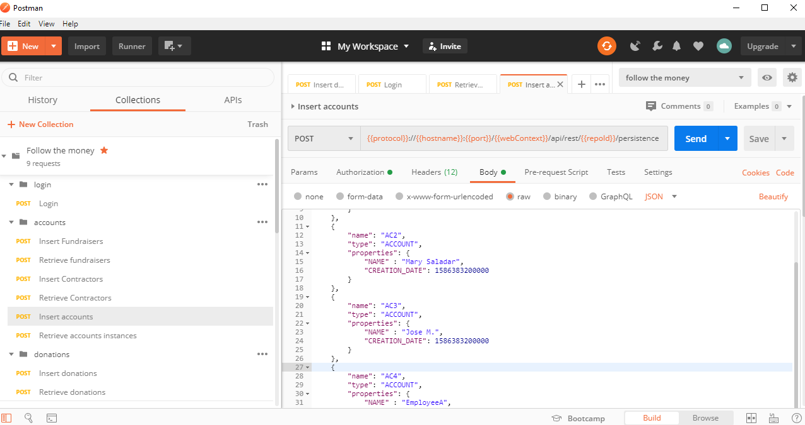
FollowTheMoney platform Architecture
Scalable, Secured, Agile, Open
Postgres RDBMS
OC billing
Meveo web components Github pages
Github
GIT code repository
Infinispan memory cache
Elasticsearch
Search engine
Meveo server
Protected dynamic pages
Wiki (documentation)
Security
console
uses
uses
Github pages
link
link
Admin console
Issues & Features
REST API
Website frontpage
FollowTheMoney.site

Slide 2














FollowTheMoney opensource stack (tiny part of)
Standing on the shoulders of giants
MEVEO

Slide 3
FollowTheMoney cutting edge technology
JavaEE scalable & transactional backend
Frameworkless frontend (vanilla js with webcomponents)
Rest API (openAPI latest standard)
Docker containers
Kibana monitoring

Slide 4



FollowTheMoney team
Tony Alejandro front dev
Sebastien Michea back dev
Iman Rakhmetullin lead

